Slide 1


ENGR 1111 Intro to Engineering: Civil Engineering Fall 2022 Part 6: Environmental Engineering Case Studies

Slide 2
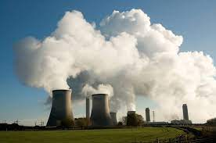

Part 5: Environmental Engineering Case Studies
Environmental Disasters
Anthropogenic
Environmental pollution and pollutants originating in human activity
Naturally Occurring Disasters

Slide 3
Part 5: Environmental Engineering Case Studies
Environmental Disasters
Naturally Occurring
Global Epidemics
2004 Earthquake and Tsunami
Hurricanes Katrina, Sandy, Harvey, Irma and Maria
1999 Turkish Earthquakes
1953 Dutch Flood Disaster
Wildfires
Mount Pinatubo Volcanic Eruption
Ellington, Missouri Tornado

Slide 4
Part 5: Environmental Engineering Case Studies
Global Epidemics
Plague
In the fourteenth century Europe, Asia and Africa were hit with a serious outbreak of the plague, now commonly known as The Black Death. The disease is caused by the bacterium Pasteurella pestis or Yersinia pestis, which is transmitted from rodents to humans by a flea.
Symptoms include fever, delirium, pneumonia and enlarged, pus-filled lymph nodes. These nodes would open to the skin and drain spontaneously.
Between 1347 and 1351, 25 and possibly 75 million people died of the plague, destroying the European social structure.
Death tolls caused the disappearance of law enforcement, religious ceremonies and medical practice in the areas where the plague was worst.
Plague epidemics ceased and are controlled by better hygiene and medication

Slide 5
Part 5: Environmental Engineering Case Studies
Global Epidemics
Spanish Flu
The Spanish Flu, also known as the Great Influenza Epidemic, was an epidemic that killed some 50 to 100 million people worldwide in 1918 and 1919 WWI. It was one of the deadliest global epidemics in human history.
The disease was called ‘Spanish Flu’ because it received the greatest media attention in Spain. Spain suffered one of the worst early outbreaks of the disease, with some 8 million people infected in May of 1918.
Symptoms of the Spanish Flu included a blue tint to the face and coughing up blood caused by severe obstruction of the lungs.
Rapid movement of soldiers and weakened immune systems because of chemical warfare contributed to the spread of the Spanish Flu during World War I. The epidemic eventually killed at least as many people as the war itself.

Slide 6
Part 5: Environmental Engineering Case Studies
Global Epidemics
HIV/AIDS
From 1980 to 2001 an estimated 62 million people were infected with the HIV virus globally, which is roughly 0.5% of the world population.
The virus is spread through bodily fluids
When someone is HIV positive, treatment is required. HIV cannot be cured, but transmission to AIDS can be postponed by medication.

Slide 7
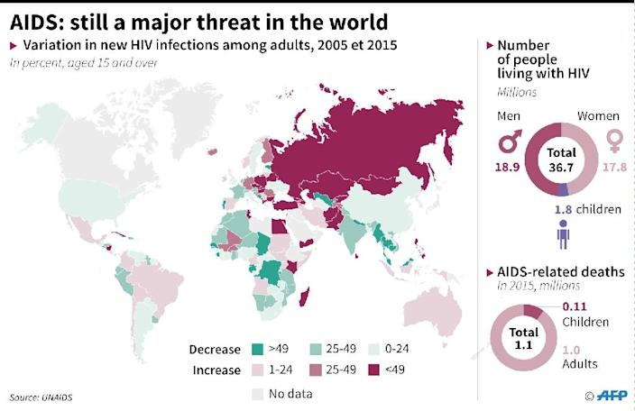
Part 5: Environmental Engineering Case Studies

Slide 8

Part 5: Environmental Engineering Case Studies

Slide 9
Part 5: Environmental Engineering Case Studies
Global Epidemics
HIV/AIDS
From 1980 to 2001 an estimated 62 million people were infected with the HIV virus globally, which is roughly 0.5% of the world population.

Slide 10
Part 5: Environmental Engineering Case Studies
2004 Earthquake and Tsunami
In December 2004, an oceanic earthquake of 9-9.3 on a Richter scale caused devastation in Asian countries.
Among the 10 deadliest in history
It lasted nearly ten minutes when most major earthquakes last no more than a few seconds.
Other earthquakes > 9.0 scale
1960 Great Chilean Earthquake (9.5)
1964 earthquake in Prince William Sound (9.2)
1957 earthquake near the Andreanof Islands (9.1).
All these areas were less densely populated than the Asian earthquake area in 2004 and therefore had a much smaller death toll
The earthquake centered in the Indian Ocean off the coast of northern Sumatra, Indonesia. It caused the entire planet to vibrate at least a few centimeters. It also triggered earthquakes in entirely different regions, such as Alaska.

Slide 11
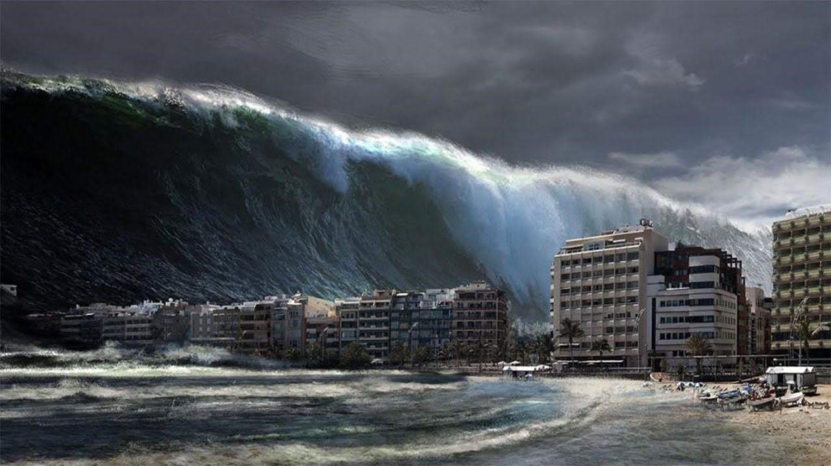
Part 5: Environmental Engineering Case Studies
2004 Earthquake and Tsunami
The earthquake resulted in a tsunami, a series of harbour waves of more than 30 meters high. It caused serious damage and killed people in Sri Lanka, South India, Thailand, Indonesia, Somalia, Myanmar, Malaysia, the Maldives and other countries. The death toll, which is now estimated at between 230,000 and 310,000 people. Tens of thousands of people are still missing. The death toll of the Asian earthquake is surpassed only by an earthquake in China in 1557, which killed over 830,000 people.

Slide 12
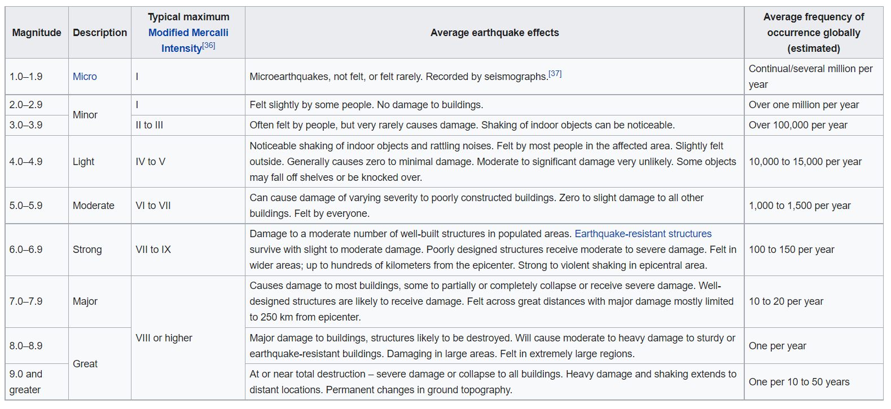
Part 5: Environmental Engineering Case Studies

Slide 13
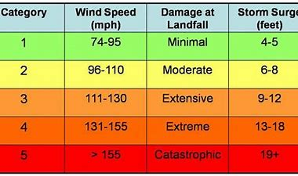
Part 5: Environmental Engineering Case Studies
Hurricanes

Slide 14
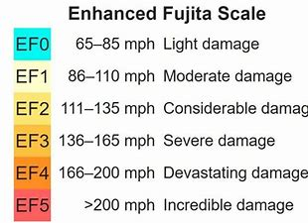
Part 5: Environmental Engineering Case Studies
Tornadoes

Slide 15
Part 5: Environmental Engineering Case Studies
Dutch Flood Disaster
January 31 of 1953 the Dutch weather service gave out a warning of an approaching northwester storm on the North Sea. The storm than included heavy winds of 150 km/h.
In 1916, strong dikes were built that gave people a false sense of safety.
Communication was limited, causing storm warnings to pass over many people. Most people did not have television, there were no nocturnal radio broadcasts and most people did not own telephones, causing many to be unaware of the danger ahead. The storms caused a change in the water level. The expected ebb tide stayed out and spring tide was reached somewhere in the middle of the night. At 2:00 the Netherlands started flooding, causing dikes to break through at more than 60 locations in three provinces. The southern islands were almost completely flooded, causing thousands of houses and farms to be ruined or dragged into sea. People were fleeing to higher places, such as dikes and attics and were trapped there. On Sunday afternoon the flood increased and water levels were even higher than the previous night. The floods caused a total of 1835 deaths. In some villages up to 10% of the population was killed. More than 47.000 cows and pigs and more than 140.000 pieces of poultry drowned during the flood. A total of more than 200.000 hectares was flooded and 72.000 people were evacuated from their homes. The 1953 flood became the largest natural disaster since the 1570 flood.

Slide 16
ENGR 1111 Intro to Engineering: Civil Engineering Fall 2022 Part 6: Environmental Engineering Case Studies

